Slide 1

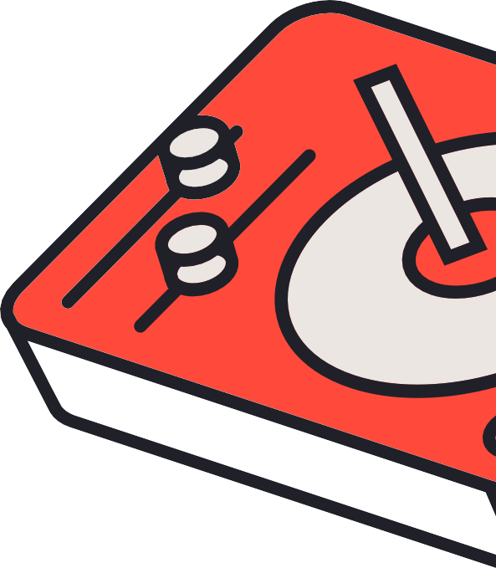


AUDIOS AUDIO INC.
MUSIC PLAYER
Let music flow in your heart and enrich your soul

Slide 2
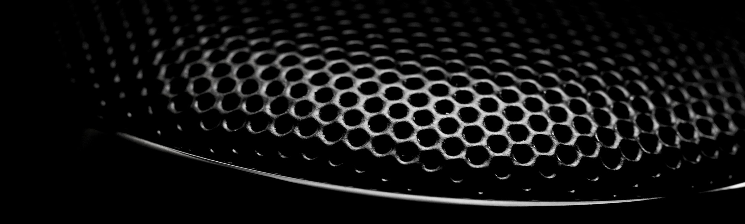
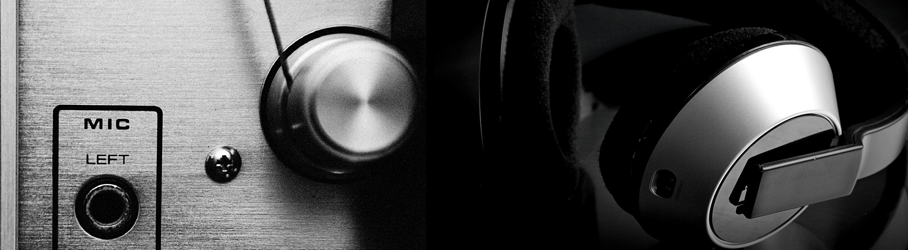
PARTICIPANTS
Adnan Naeem 079
Zain illyas 067
M. KhizZar Jamil Awan 111
AAI | Pro X

Slide 3
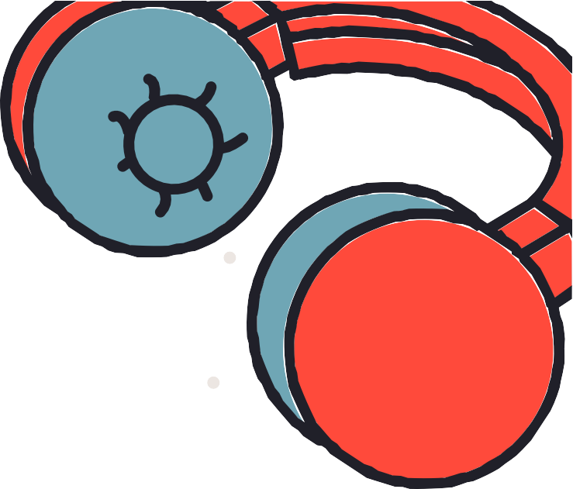

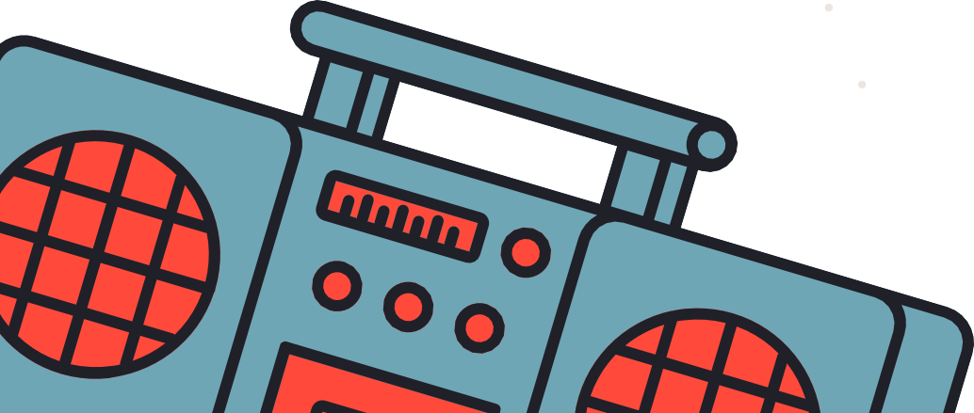
MUSIC PLAYER INTRODUCTION
MUSIC PLAYER THIS MEANS THAT A PHONE INCLUDES MEMORY STORAGE FOR MP3, AAC OR SIMILAR MUSIC FILES, AND SOFTWARE FOR PLAYING THAT MUSIC.

Slide 4


FEAUTURES OF MUSIC PLAYER
A BASIC MUSIC PLAYER INCLUDES FOLLOWING FEATURES :
It consist of a play button, pause button, forward and reverse button
It allows you to create a well-organized media library from your local collection.
It helps you sync data with smartphones and offers easy visualization.

Slide 5

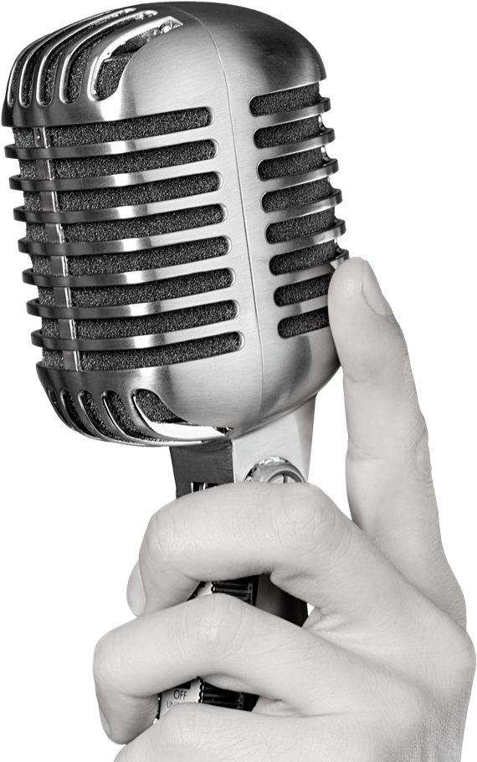
WHY MUSIC PLAYER IS
IMPORTANT AND ITS TOOLS
MUSIC CAN PROVIDE AN ESCAPE FROM EVERYDAY LIFE OR AN ALTERNATIVE MEANS OF EXPRESSING ONE'S OWN CAPABILITIES
TOOLS:
WE ARE USING PYTHON LANGUAGE FOR THIS
WE ARE USING PYCHARM COMMUNITY EDITION 2020.3.3 X 64

Slide 6
WHAT IS PYTHON AND PYCHARM
Item 5
20%
Item 1
20%
PYTHON IS AN INTERPRETED HIGH- LEVEL GENERAL-PURPOSE
PROGRAMMING LANGUAGE
PyCharm is an integrated development environment (IDE) used in computer programming, specifically for the Python language. It is developed by the Czech company JetBrains
Item 4
20%
Item 2
20%
Item 3
20%

Slide 7
Libraries
Used in this project
Import OS
Import time
From tkinter Import *
Import tkinter.messagebox
From tkinter import filedialog
From tkinter import ttk
From ttkthness import themed_tk as tk
From pygame import mixer

Slide 8
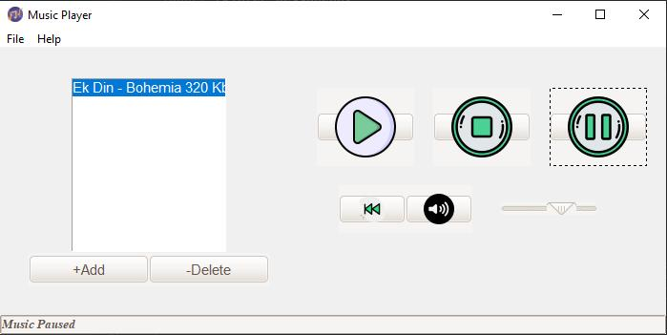
Graphical User Interface
Music Player
Stop Button
Play Button
Pause

Slide 9
Thank
You

